Slide 1

Analyzing Amazon: A Comprehensive Stock Analysis

Slide 2

Introduction
Welcome to our presentation on Amazon Stock Analysis, based on data collected and analyzed using an Excel dashboard.
Amazon, as one of the world's largest e-commerce and cloud computing companies, has become a key player in the global market. Understanding the performance of Amazon stock is essential for investors looking to capitalize on opportunities in the stock market. In this presentation, we will analyze the various aspects of Amazon's stock performance using a comprehensive Excel dashboard. By examining daily changes, monthly averages, trading volume, and more, we aim to provide valuable insights for investors. Let's dive into our analysis and uncover key trends and patterns in Amazon's stock performance.

Slide 3

Importance of Amazon Stock Analysis
Before delving into our analysis, let's understand why analyzing Amazon stock is crucial for investors.
Analyzing daily changes in Amazon's stock value helps investors identify trends, anomalies, and potential buying or selling opportunities.
Examining monthly average closing values provides insights into long-term trends and the overall performance of Amazon stock.
Understanding the daily low and high of Amazon stock helps gauge investor sentiment and identify potential market opportunities.
Analyzing trading volume helps assess market liquidity and investor interest in Amazon stock.
Exploring the relationship between daily changes in high-low and trading volume provides insights into stock volatility and investor behavior.

Slide 4
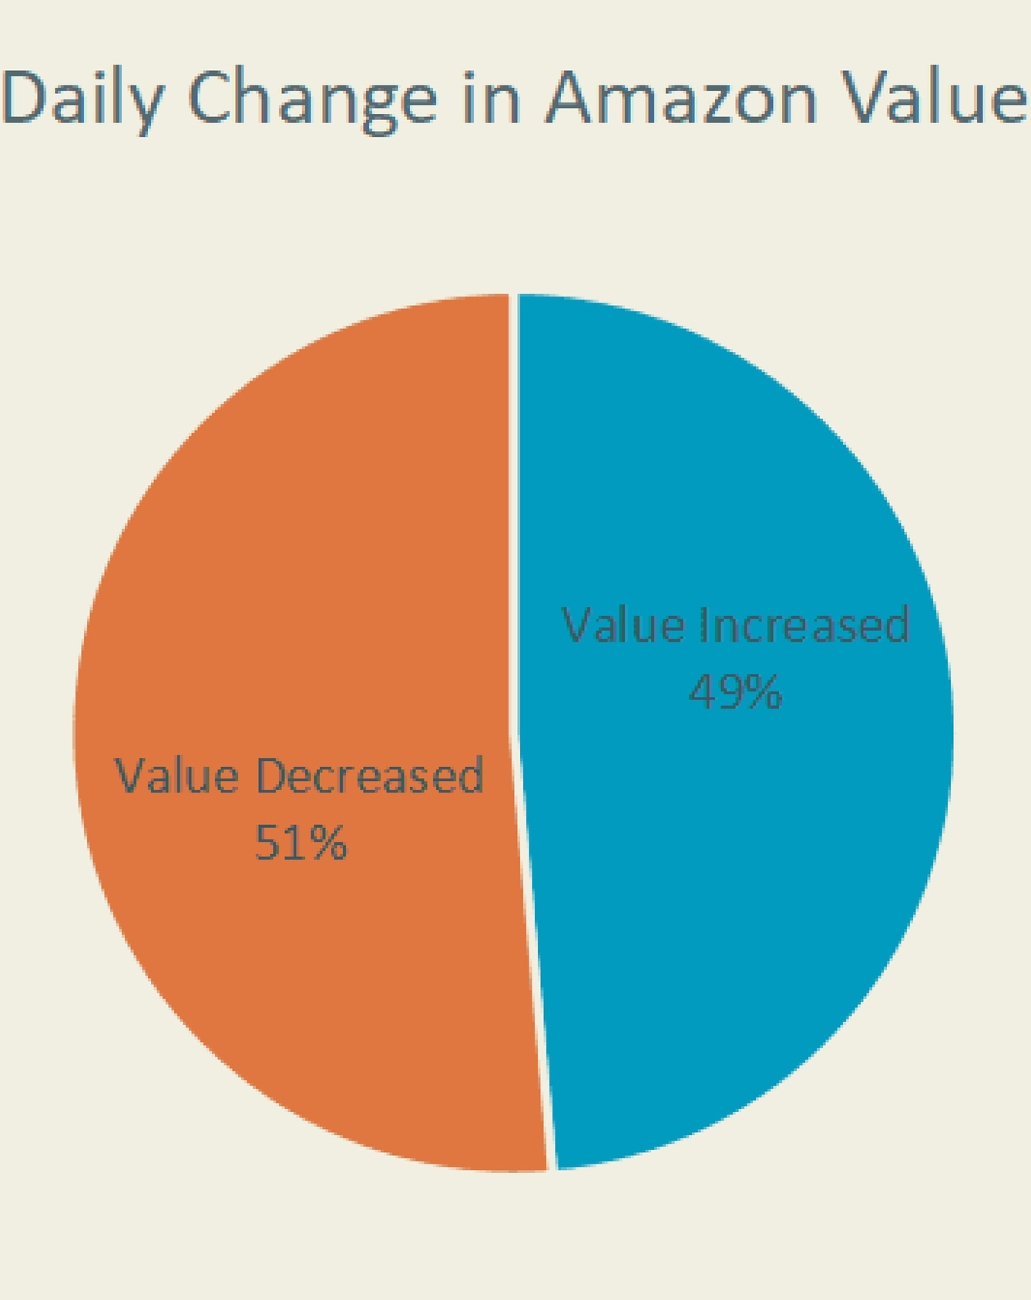
DailyChange in Amazon Value
Daily Change Visualization: Graph: Pie chart showing the distribution of daily changes in Amazon's stock value.
Increased value represented in blue.
Decreased value represented in orange.
Analysis:
Interpretation of significant changes.
Identification of trends and anomalies.
Discussion on factors influencing these daily fluctuations.

Slide 5
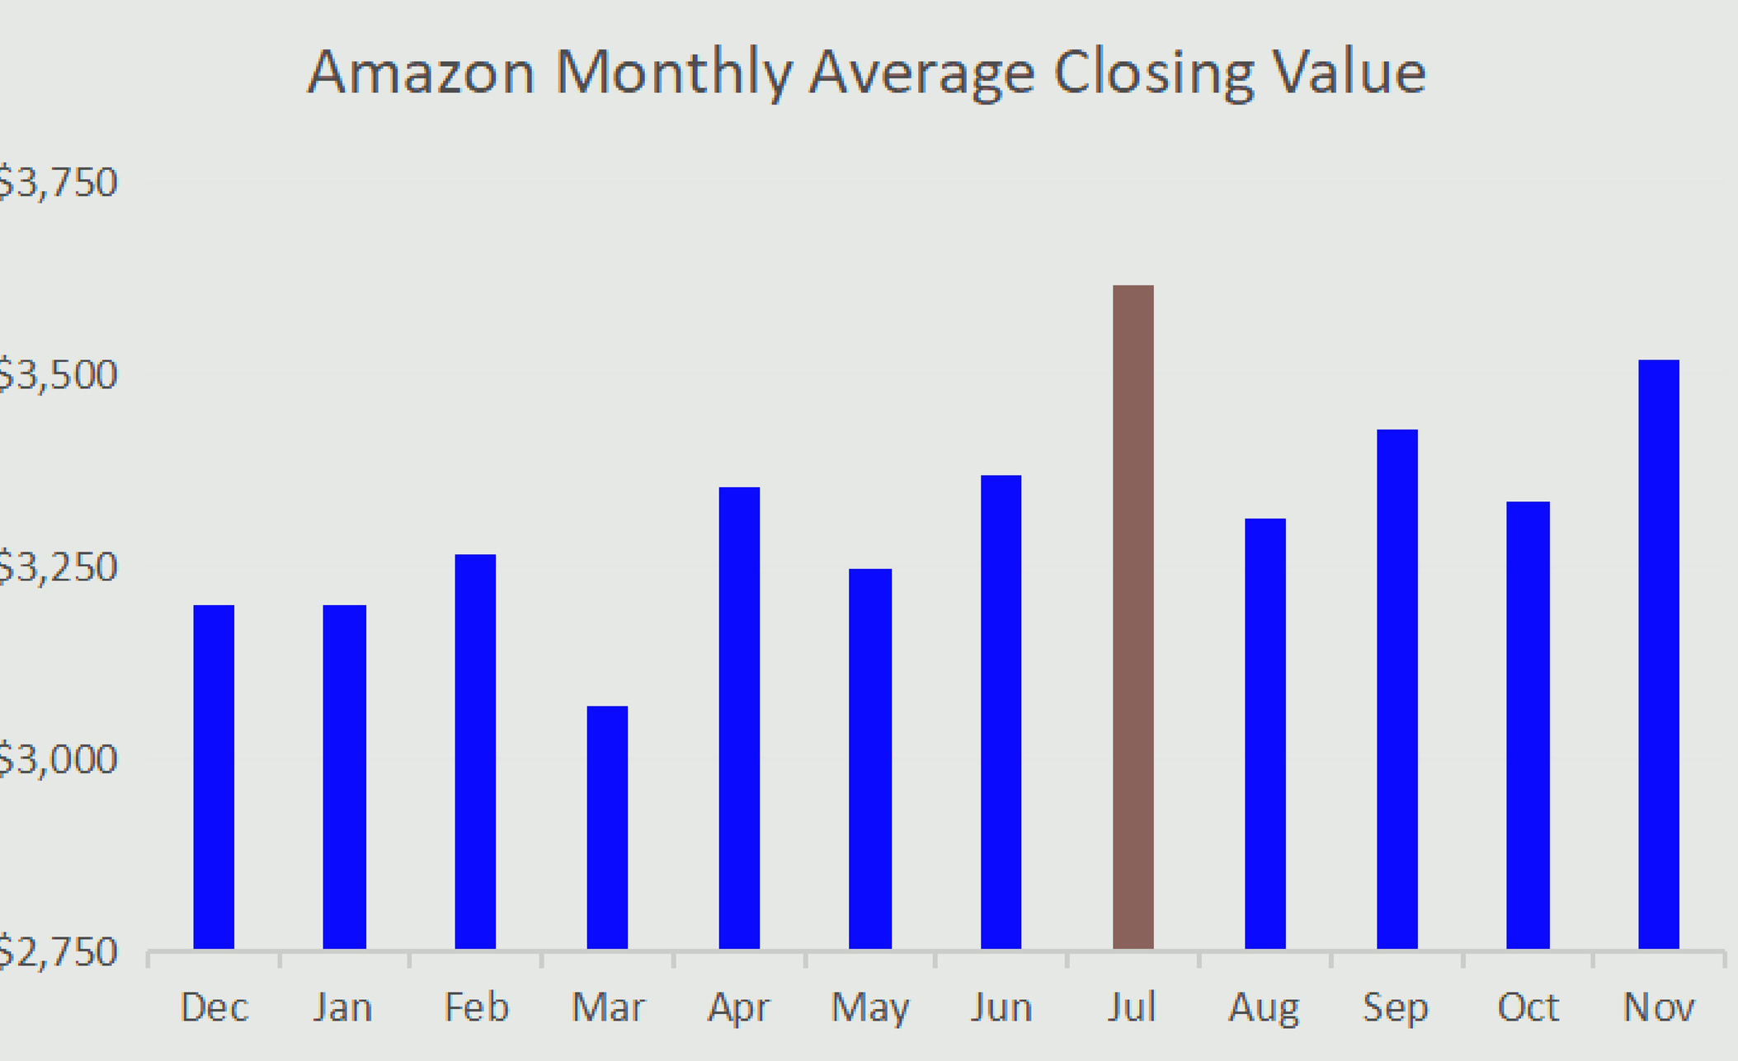
Amazon Monthly Average Closing Value
Monthly Average Visualization:
Graph: Bar chart illustrating the monthly average closing value of Amazon stock over the past months.
Trend Analysis:
Examination of trends observed in monthly averages.
Identification of significant increases or decreases.
Comparison with industry averages and competitors.
Understanding these trends provides valuable insights into the overall performance of Amazon stock in the market.

Slide 6

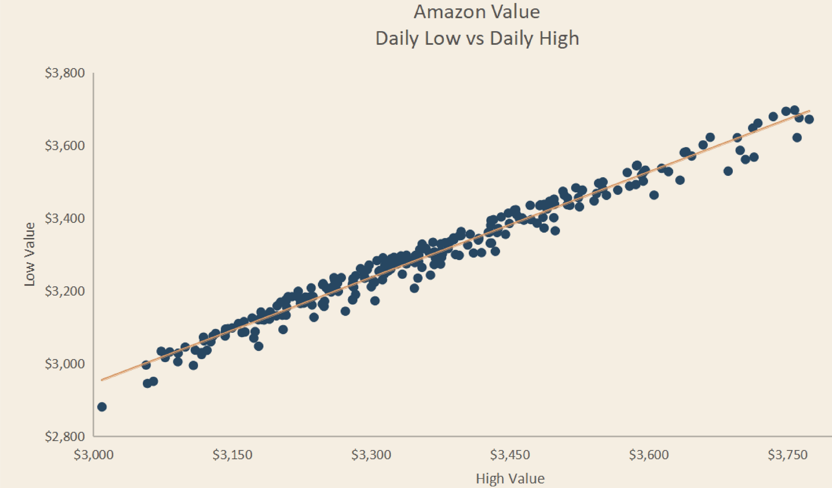
Daily Low vs. Daily High
Low vs. High Visualization:
Graph: Line chart illustrating the daily low vs. daily high of Amazon stock.
Spread Analysis:
Interpretation of the spread between daily low and high.
Discussion on how this spread reflects investor sentiment and market volatility.
By analyzing the daily low and high, investors can identify potential buying or selling opportunities and make informed investment decisions.

Slide 7

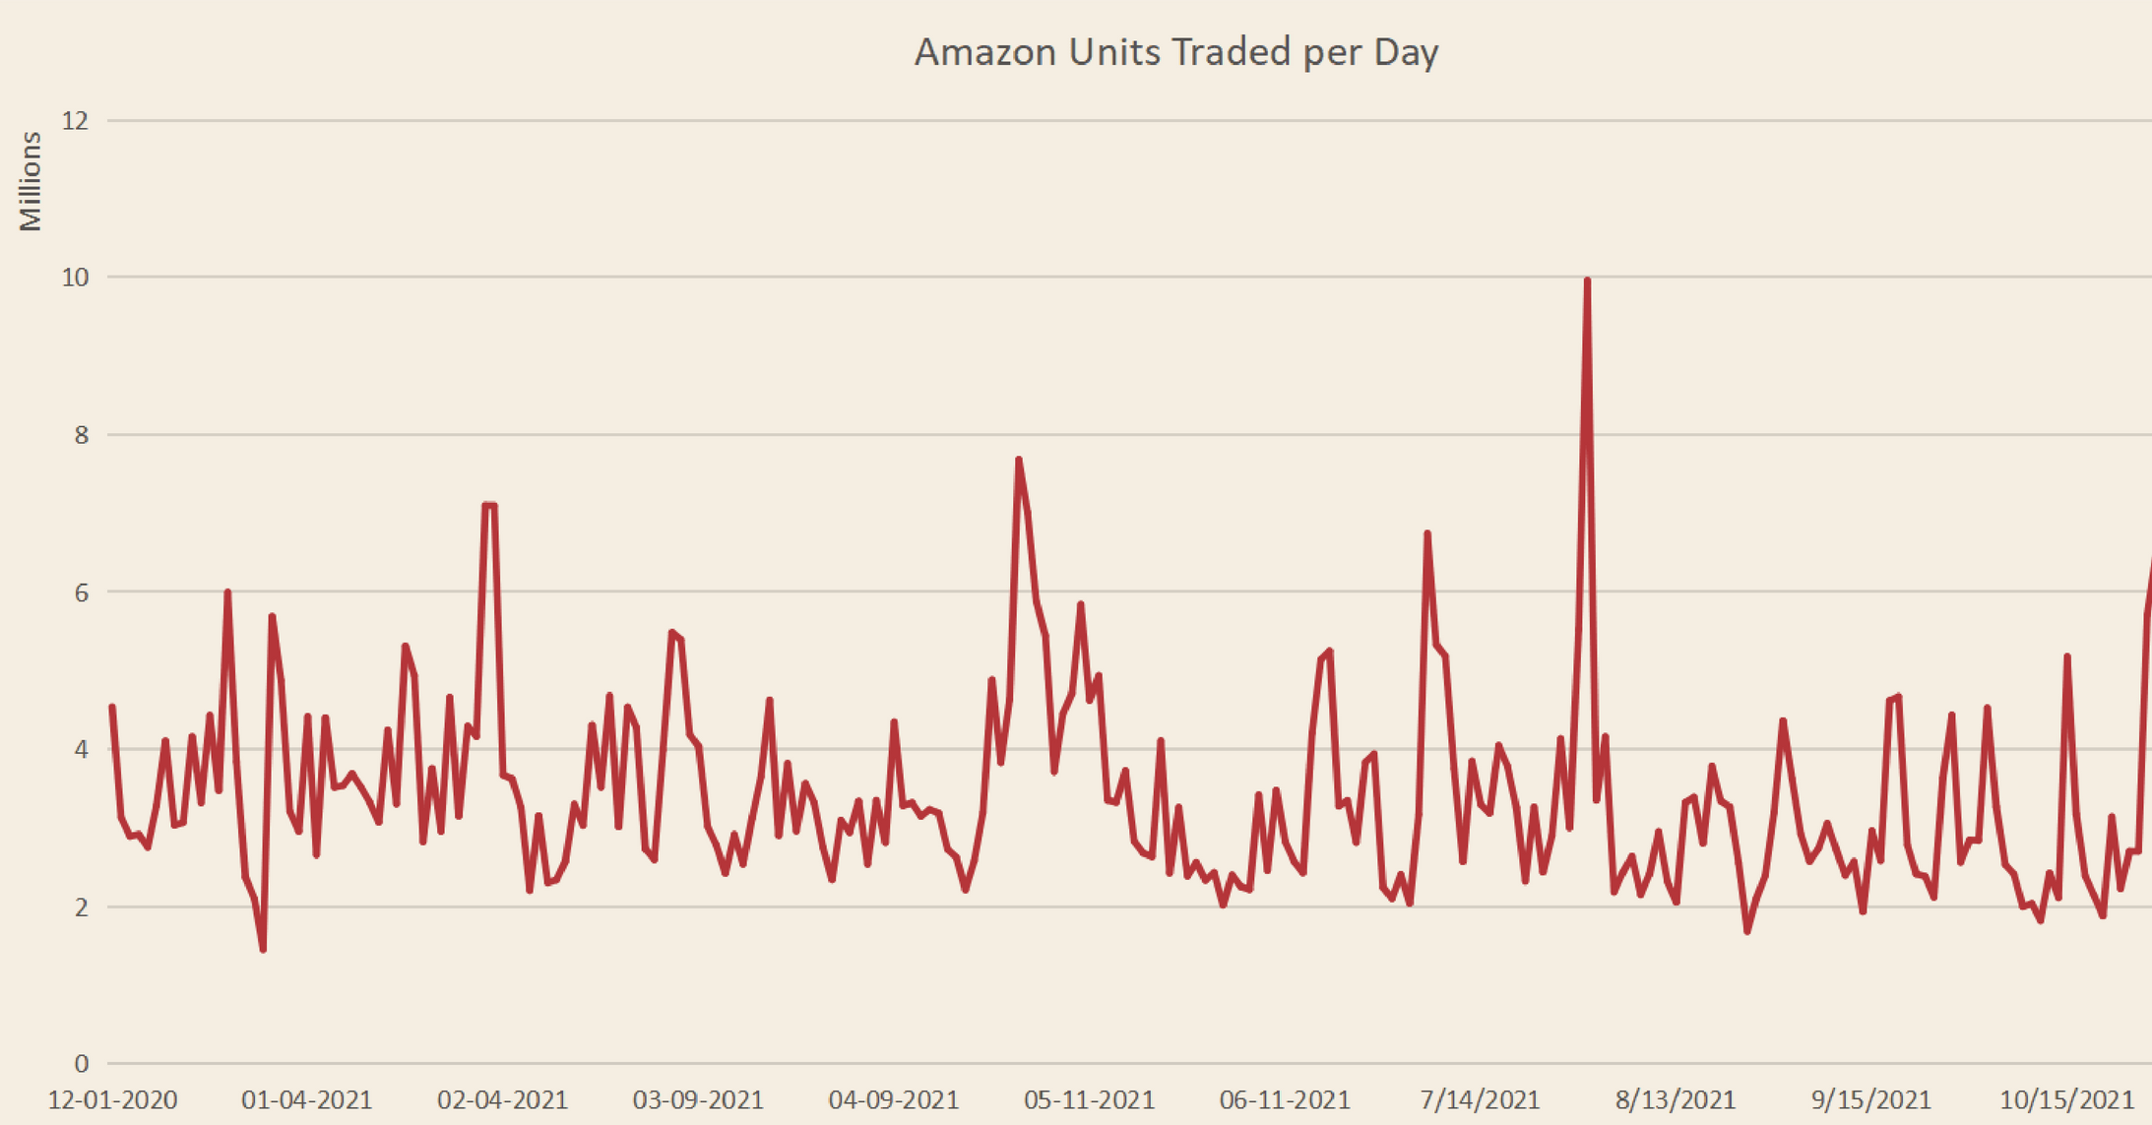
Amazon Units Traded Per Day
Trading volume is a key indicator of market activity and investor interest in a stock. Let's analyze the number of Amazon units traded per day.
Trading Volume Visualization:
Graph: Line chart illustrating the number of Amazon units traded per day.
Volume Trends:
Analysis of volume trends over time.
Discussion on the correlation between trading volume and stock price movement.
Understanding trading volume helps investors assess market liquidity and investor sentiment towards Amazon stock.

Slide 8
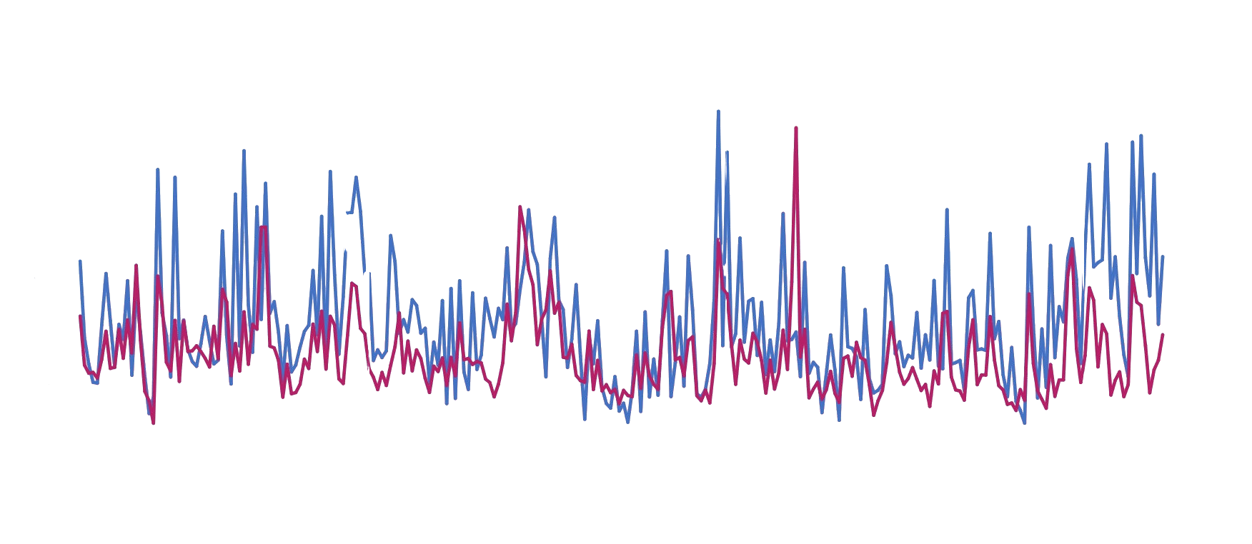
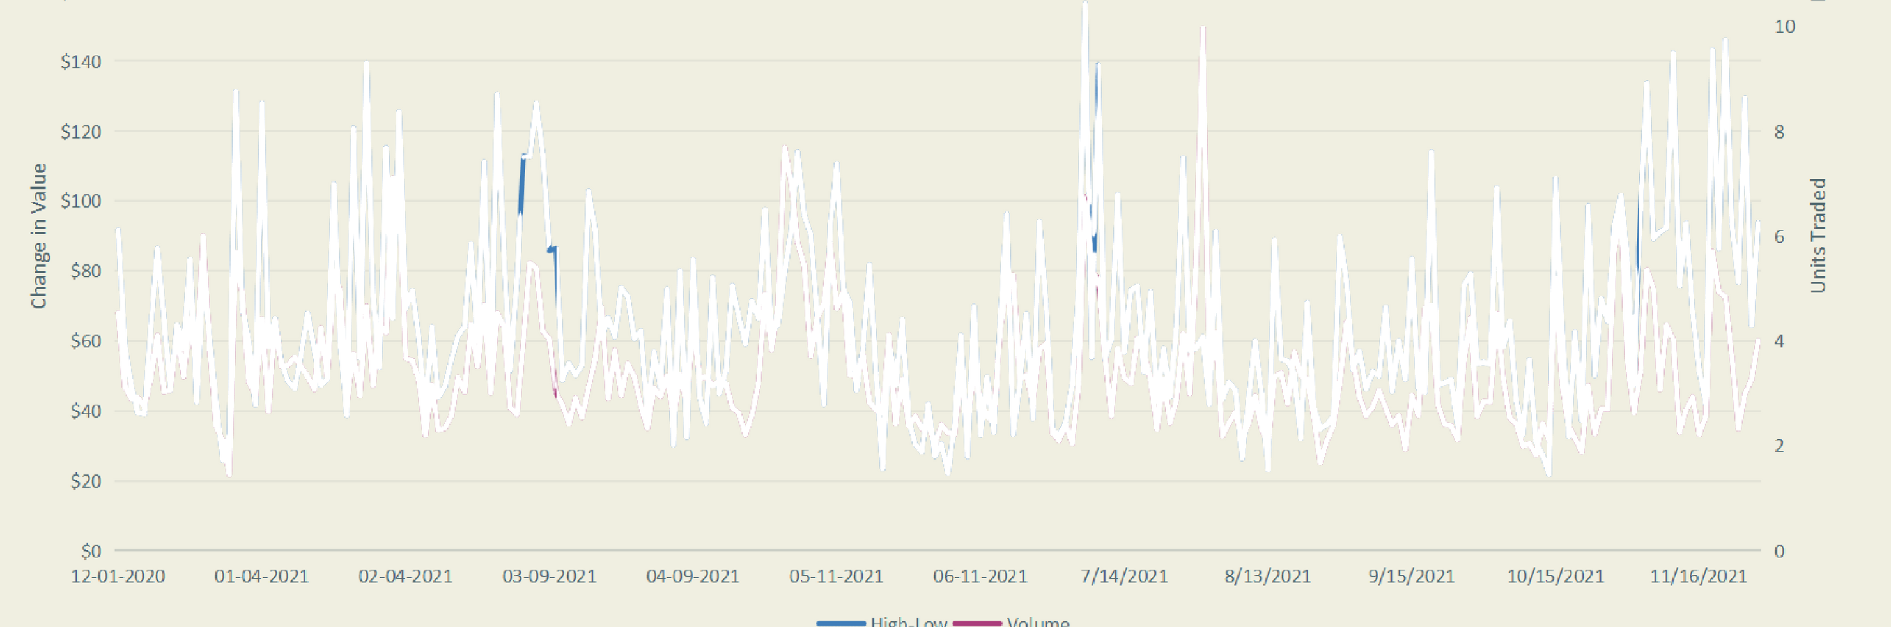
Daily Change in High-Low Compared to Number of Units Traded
Relationship Visualization:
Graph: Line chart showing the relationship between the daily change in high-low and the number of units traded.
Correlation Analysis:
Examination of the correlation between trading volume and price volatility.
Discussion on how trading volume influences the daily price range and overall stock volatility.

Slide 9
Conclusion
Summary:
In conclusion, our analysis of Amazon stock provides valuable insights for investors:
Daily Change Analysis: Understanding daily fluctuations helps identify trends and potential market opportunities.
Monthly Average Closing Value: Analyzing monthly averages reveals long-term trends and performance indicators.
Daily Low vs. Daily High: Examining the spread between daily low and high helps gauge investor sentiment and market volatility.
Trading Volume: Analyzing trading volume provides insights into market liquidity and investor interest.
Relationship Between Daily Change and Trading Volume: Understanding this relationship helps assess market dynamics and stock volatility.
Implications for Investors:
By gaining a deeper understanding of Amazon's stock performance, investors can make more informed decisions and capitalize on potential opportunities in the market.
Future Outlook:
Despite short-term fluctuations, Amazon's strong market position and continued growth prospects suggest a positive future outlook for the company's stock.

Slide 10

Thanks!
We appreciate your time and attention.
patraroni*@gmail.com +91- 9051367064

